Slide 1

Who！？
誰だ？

Slide 2
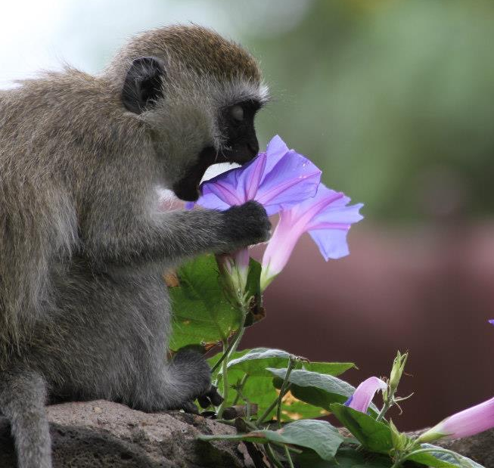
Who！？
名前： 三村 @kilometer
職業： ポスドク (こうがくはくし)
専門： 行動神経科学(霊長類)
脳イメージング
医療システム工学
R歴： ~ 10年ぐらい
流行: カメ

Slide 3
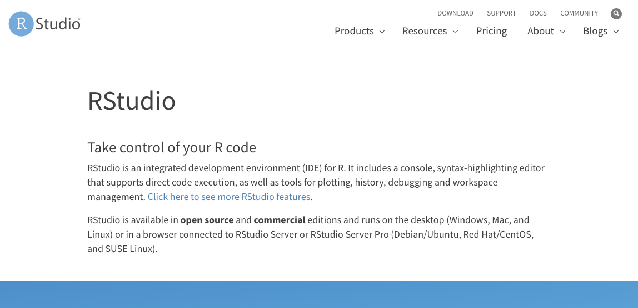
https://rstudio.com/

Slide 4


Input
Output

Slide 5
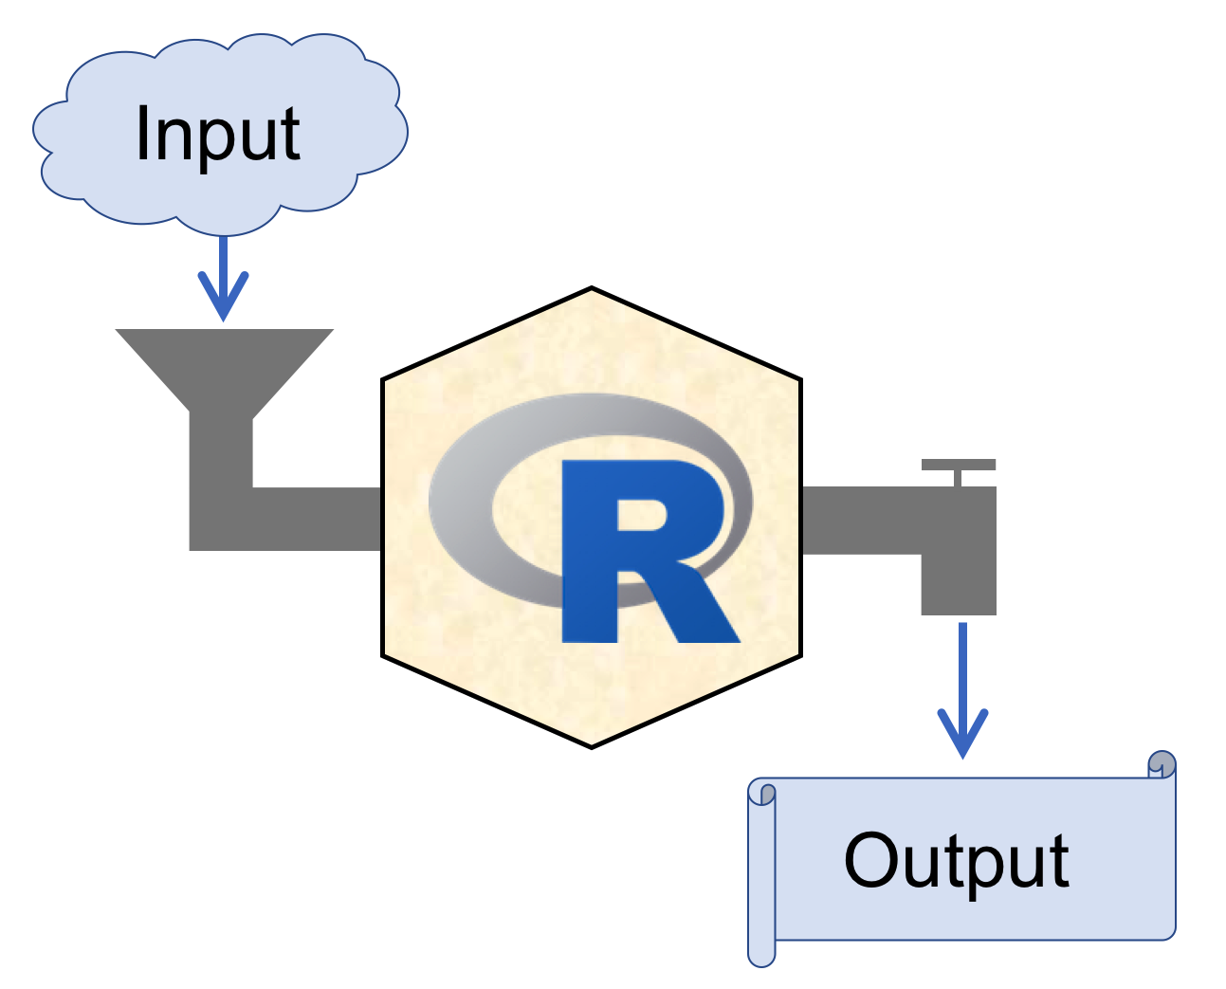

RStudio
https://rstudio.com/
Recommended!!
Integrated Development Environment

Slide 6
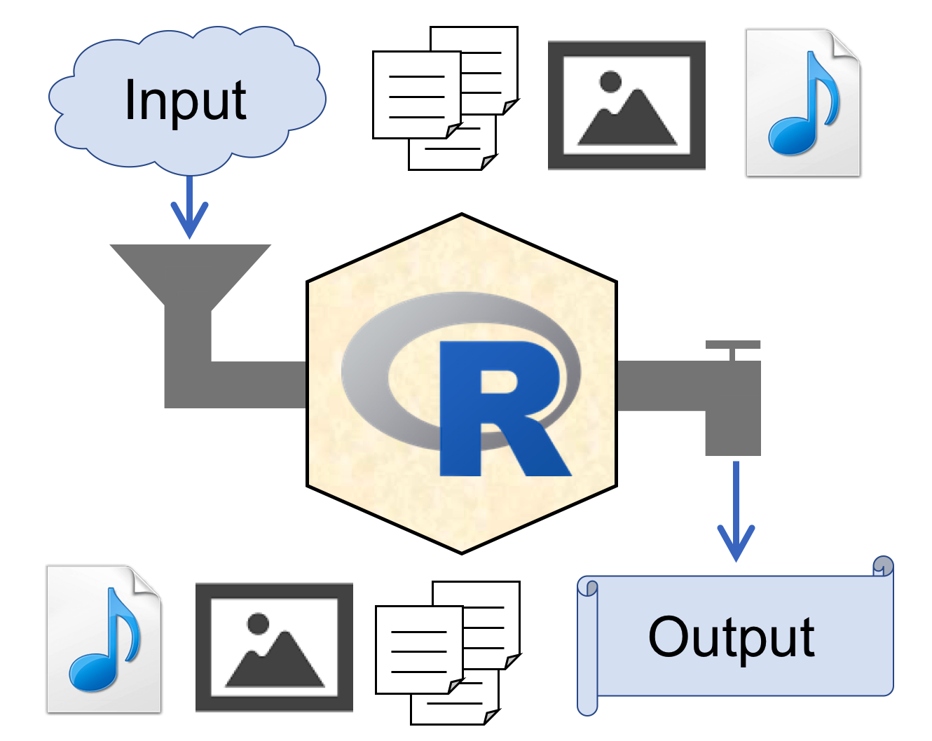
RStudio
Integrated Development Environment

Slide 7
RStudio

Slide 8
RStudio
Projects

Slide 9
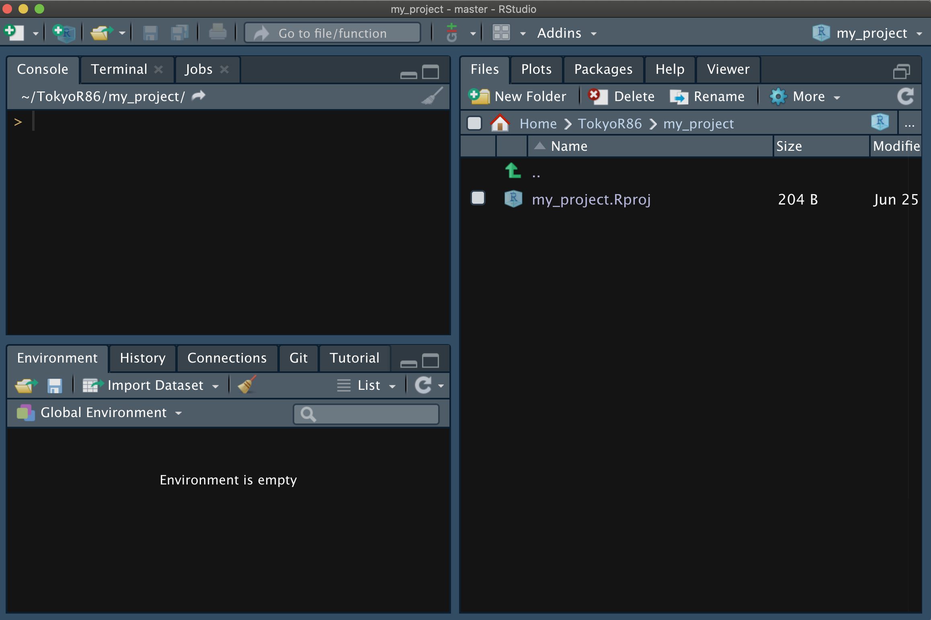
RStudio

Slide 10
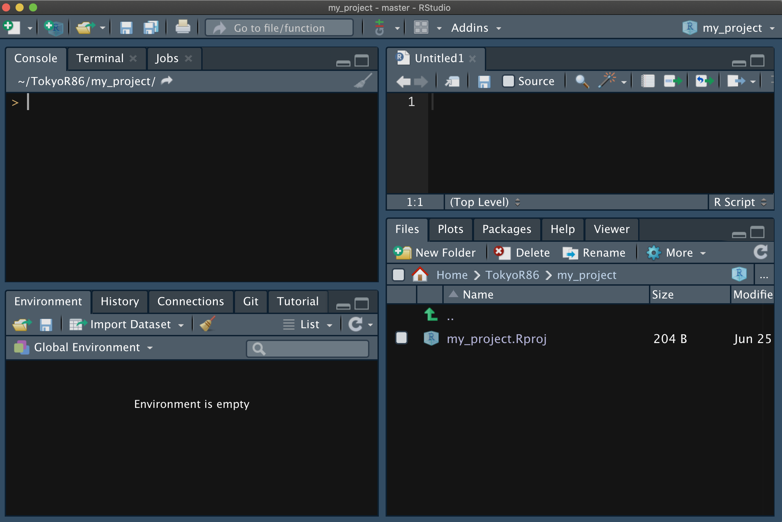
RStudio
File > New File > R script (⌘ + ⇧ + N)
Script Editor
Console
Files, Plots, Pkgs, ...
Env., HIstoly, Git, ...

Slide 11
RStudio
File > New File > R script (⌘ + ⇧ + N)
Run
≈
Script Editor
Console
Files, Plots, Pkgs, ...
Env., HIstoly, Git, ...

Slide 12
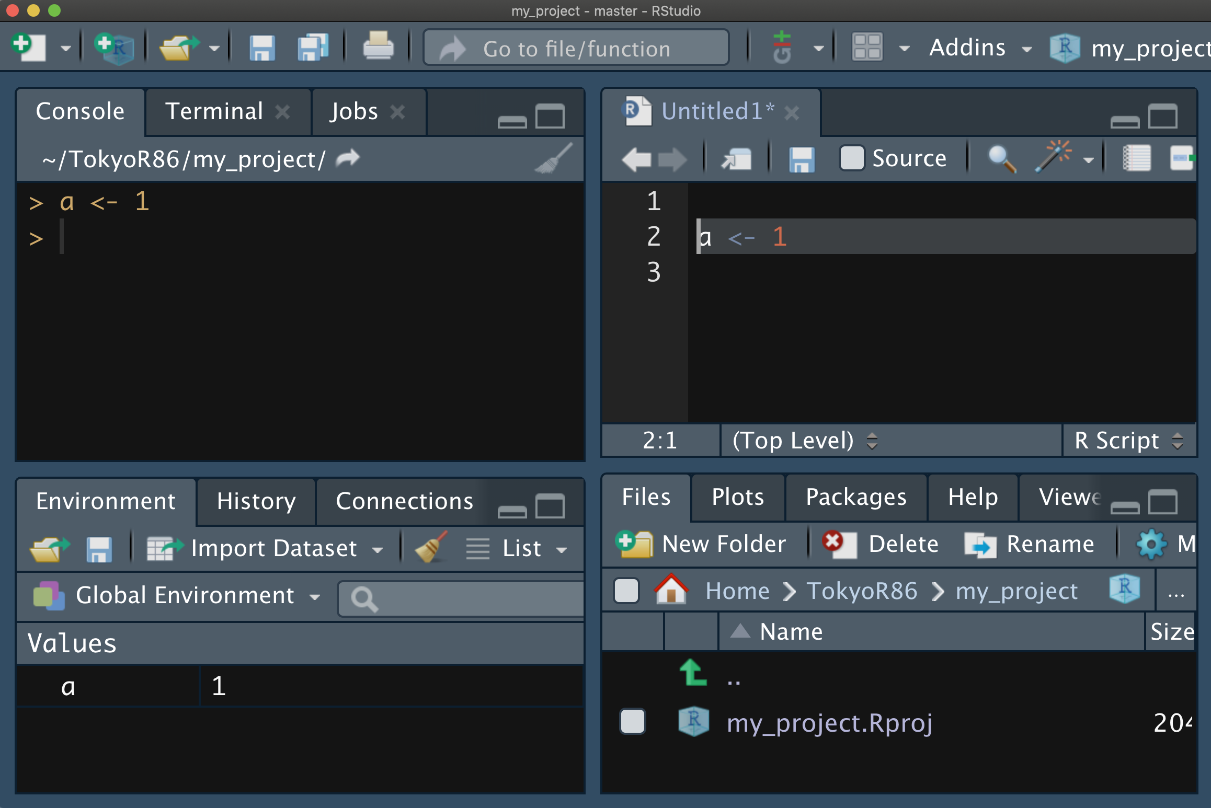
RStudio
Run
≈
select, ⌘ + ↩︎

Slide 13
RStudio
Projects

Slide 14
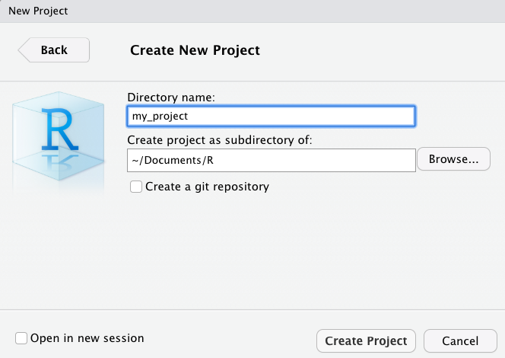
Create New Project
File > New Project > New Directory > New Project >

Slide 15



Project Folder
~/Documents/R
Project Root folder
my_project
Workspace setting
my_project.Rproj
.Rproj.user
Open RStudio
Auto saved
working information
(Unsaved edits, tab order, etc.)

Slide 16
Project Folder
~/Documents/R
my_project
my_project.Rproj
data
fig
script.R

Slide 17
Project Folder
~/Documents/R
my_project
my_project.Rproj
data
data_raw
data_all.csv
fig
script.R

Slide 18
Project Folder
~/Documents/R
Project Root
my_project
my_project.Rproj
data
data_raw
data_all.csv
fig
Relative path
script.R
dat <- read.csv("data/data_all.csv")

Slide 19
~/Documents/R
project3
project1
project4
project2

Slide 20
Project ≠ sandbox

Slide 21

Sandbox

Slide 22
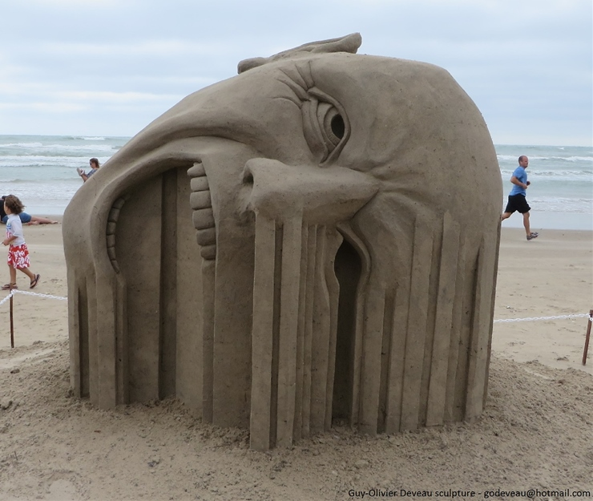

http://buzz-plus.com/2014/07/25/suna/
Sandbox
http://www.sandart-j.com/work/work3.html

Slide 23
Sandbox A
http://buzz-plus.com/2014/07/25/suna/
Sandbox B
http://www.sandart-j.com/work/work3.html

Slide 24
Sandbox A
Isolated
&
Independent
http://buzz-plus.com/2014/07/25/suna/
Sandbox B
http://www.sandart-j.com/work/work3.html

Slide 25
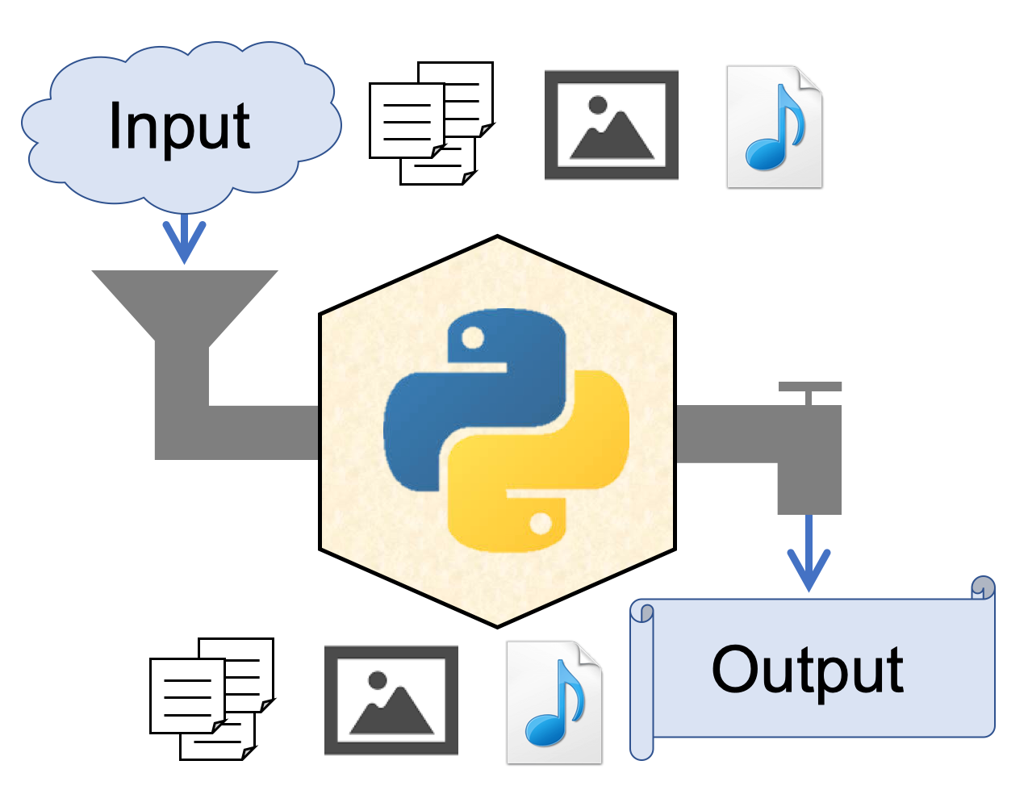
"Sandbox" in Python
[python]
version = "3.7"
[packages]
cycler==0.10.0
kiwisolver==1.1.0
matplotlib==3.1.1
numpy==1.16.4
opencv-python==4.1.0.25
pandas==0.25.0
pyparsing==2.4.0
PypeR==1.1.2 ...
[python]
version = "2.7"
[packages]
numpy==1.16.4
...
cf. https://speakerdeck.com/kilometer/tokyo-dot-r-number-80-r-interface-to-python

Slide 26
Sandbox environments?

Slide 27
R & RStudio
Projects

Slide 28
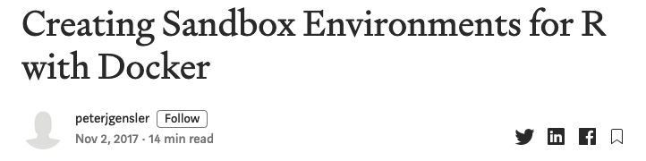
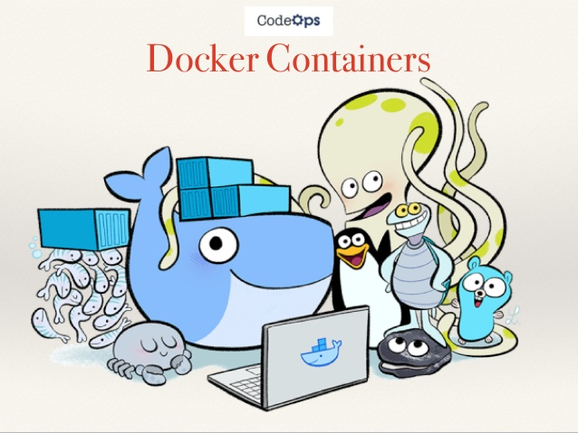
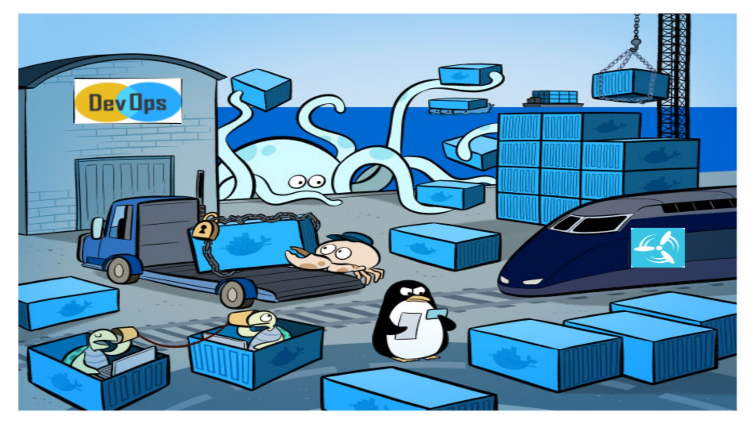
If you want,
https://towardsdatascience.com/creating-sandbox-environments-for-r-with-docker-def54e3491a3

